Slide 1
Vex Parts

Slide 2
Construction Priorities
The goal when constructing a mechanism typically falls into one of two categories:
Permanent – This type of construction emphasizes durability, but is usually more time consuming to build (and disassemble.)
Prototyping – This type of construction emphasizes speed of assembly, but such constructs are typically significantly less durable.

Slide 3
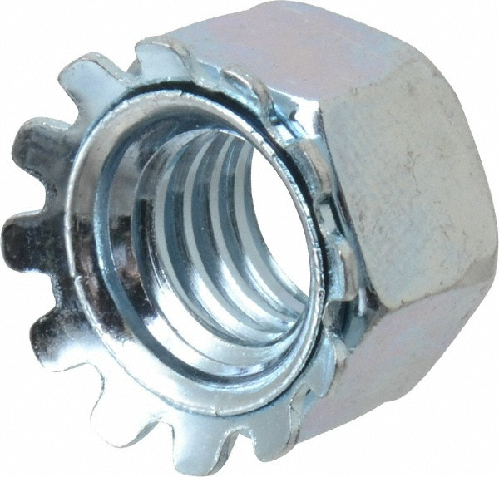
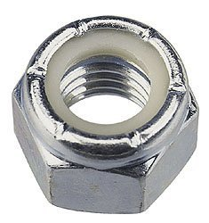
Nuts
Rapid Prototype
Permanent Construction
KEPS Nuts
Integrated toothed washer
The washer is placed against the pieces being connected.
Can be mostly hand tightened, and finished with a wrench.
Loosens rapidly with movement.
Nylock Nuts
Has an interior plastic ring that resists turning.
Must be tightened or loosened with two tools.
Large hex wrench to hold/turn bolt.
Crescent wrench to hold/turn nut.
Does not loosen with movement

Slide 4
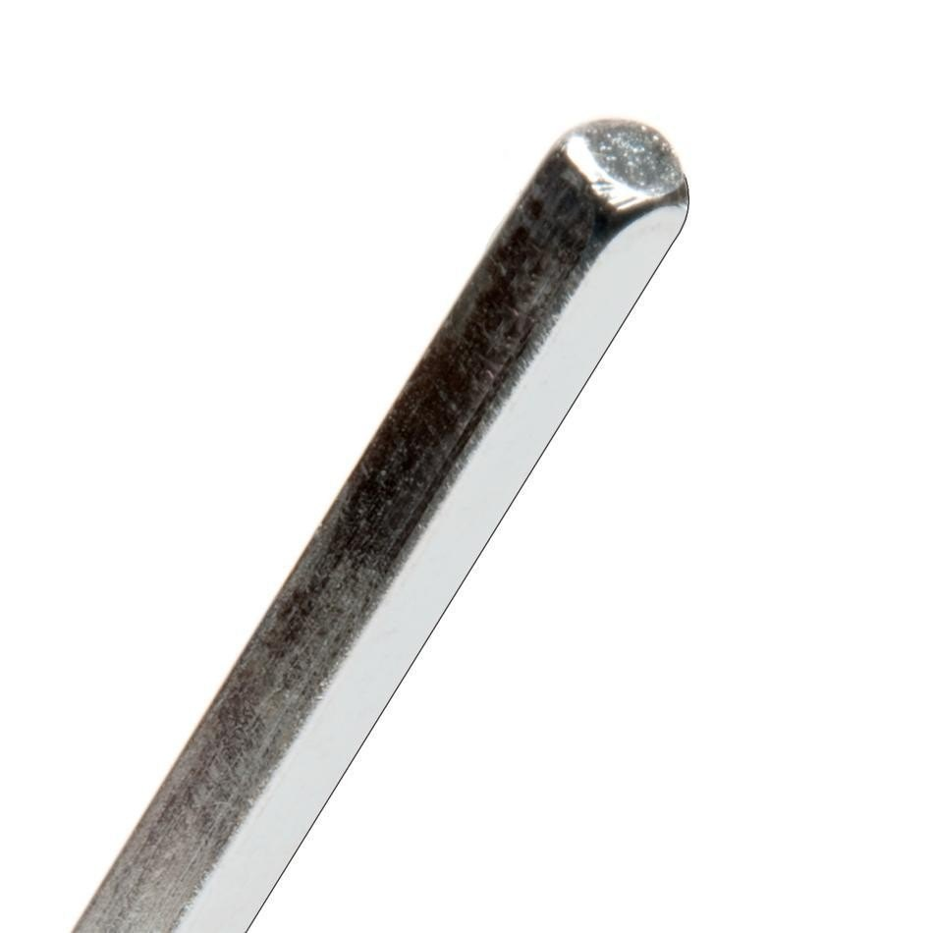
Drive Shafts
Also called axles. Come in Lengths of 12” and less than 6”
Drive shafts support wheels, gears, and other mechanisms.
Drive shaft must ALWAYS be supported in two separate locations by a combination of two:
Motors
Delrin Bearings
Pillowblock Bearings
Lock Plates

Slide 5
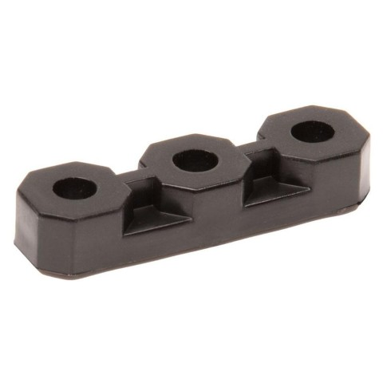
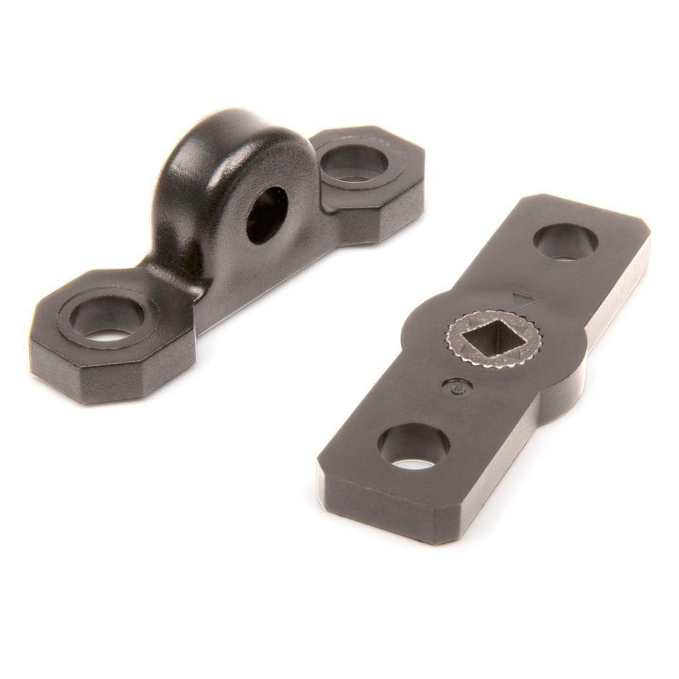
Bearings
Bearings “bear” or support drive shafts.
They either allow a shaft to turn freely with minimal friction, or lock it in place so it cannot turn, or connect it to a motor so it turns with the motor.
Pillowblock Bearing – Supports parallel to structure.
Delrin Bearing Flat – supports at right angle to structure.
Lock Plate – Supports without turning.

Slide 6
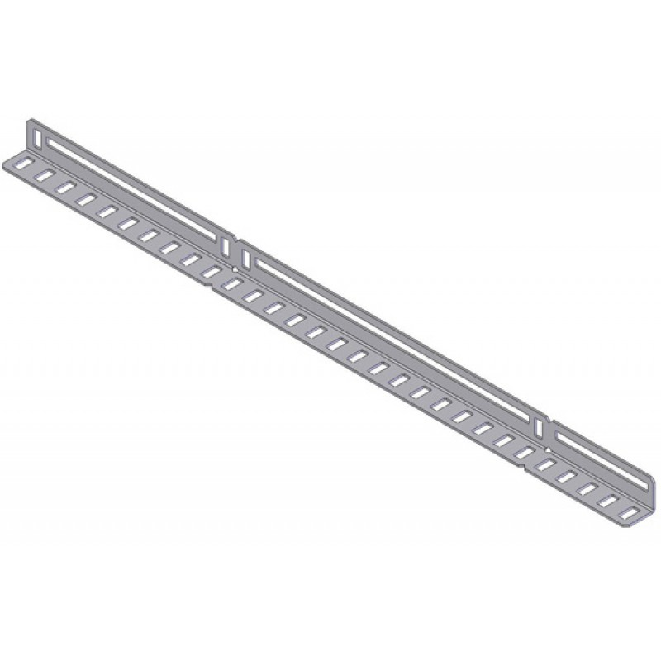
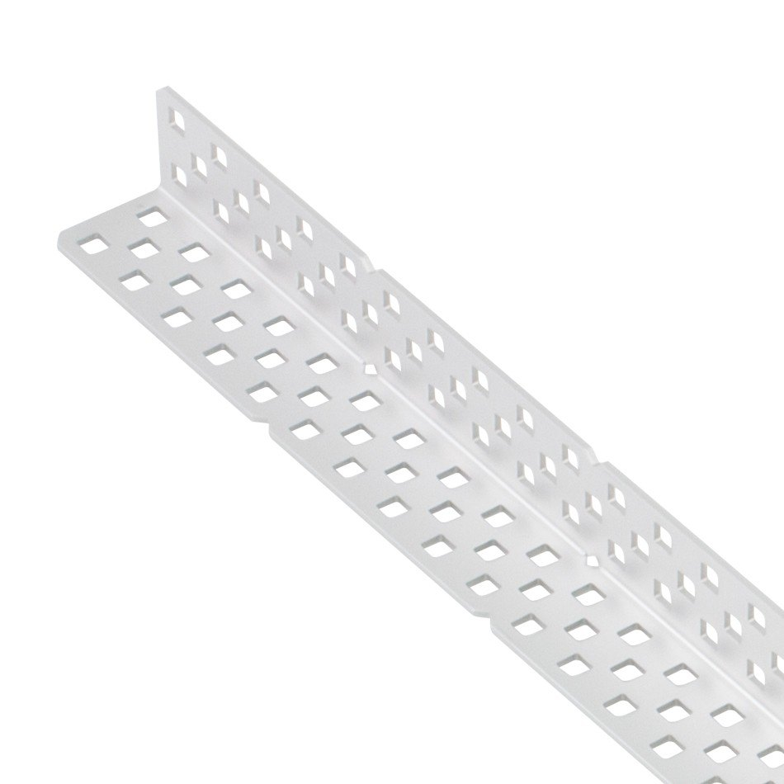
Attachment Points
Holes
Slots
Holes on equivalent structural parts will automatically line up, making it easy to support shafts.
Holes on different structural parts may not line up.
Slots allow structures attached with bolts to have their attachment point adjusted along the length of the slot.
This makes it easier to line shafts up.

Slide 7
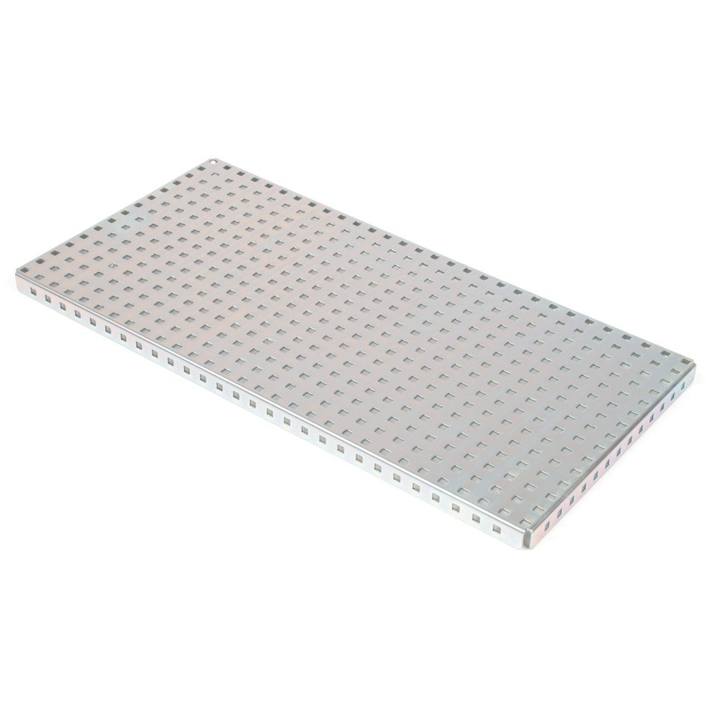
Baseplates
Large metal attachment plates.
Suitable for forming large stable bases, or large walls for attachment of multiple parts.
These are labeled for purposes of identification.

Slide 8
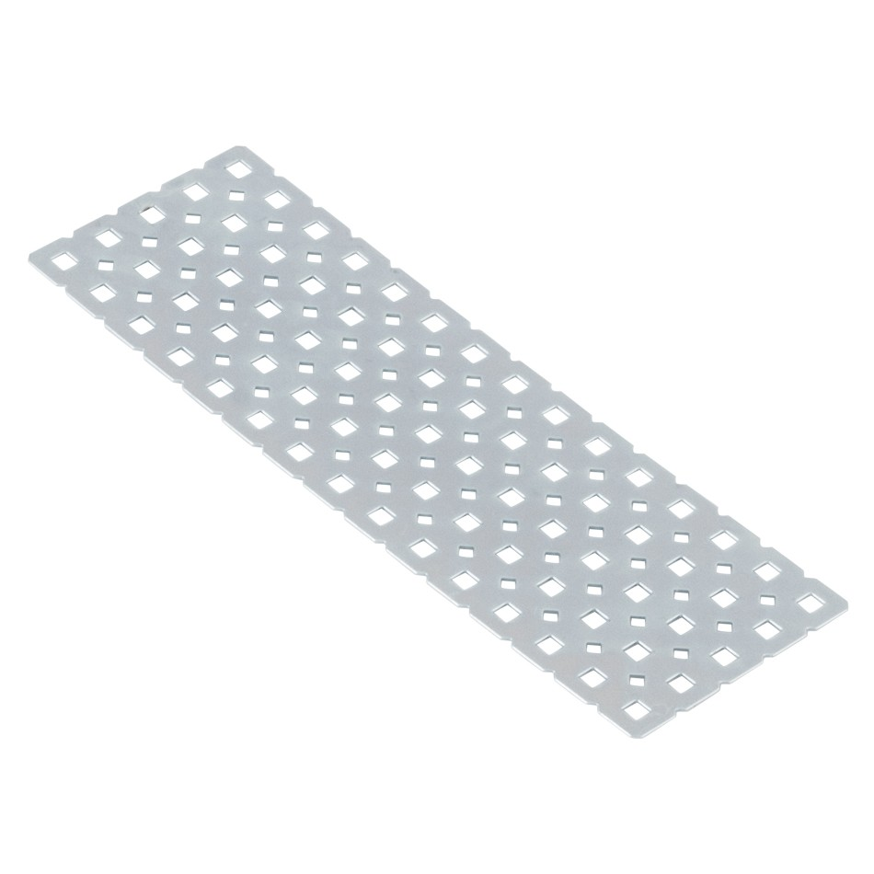
Plates
Flat surfaces that provide attachment points.
These come in multiple sizes.
May be bent: DON’T.

Slide 9
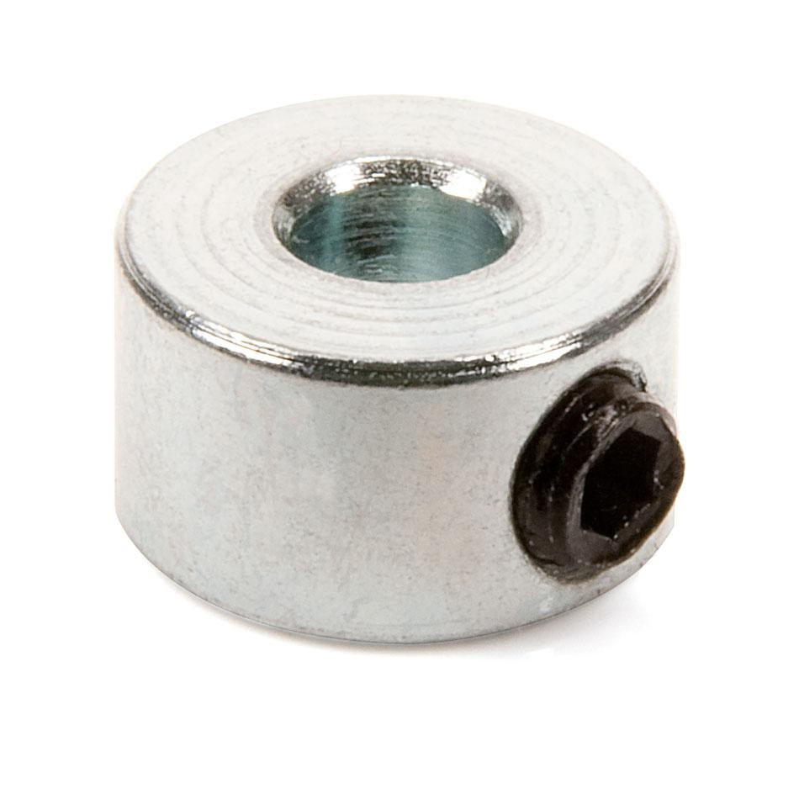
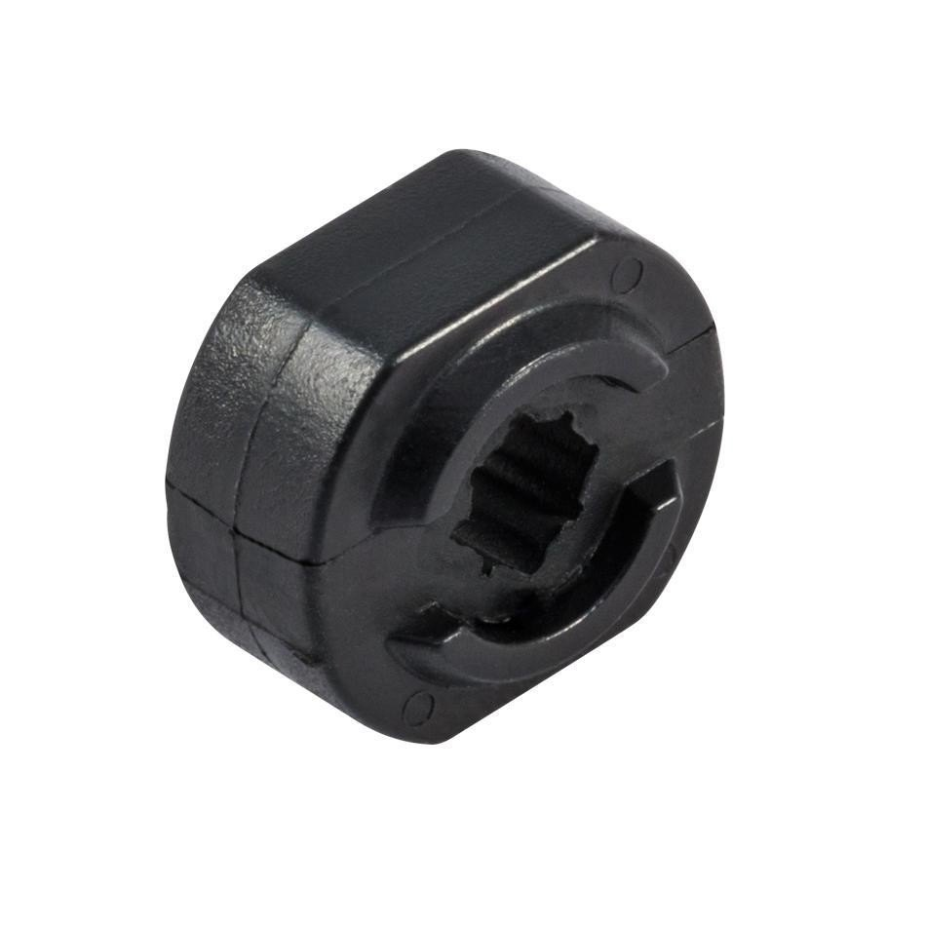
Shaft collars
Clamping shaft collar – has a small 5/64” internal screw that can be tightened against the flat surface of a shaft, locking the collar in place.
The internal screws are small and get lost easily if unscrewed until they fall out.
The internal screws can be stripped easily if overtightened.
Best for resisting strong forces.
Rubber shaft collar – has a slightly smaller diameter, and is elastic. Can be slid onto a shaft, and is held in place by friction.
Easier to put on.
Cannot resist strong forces.

Slide 10
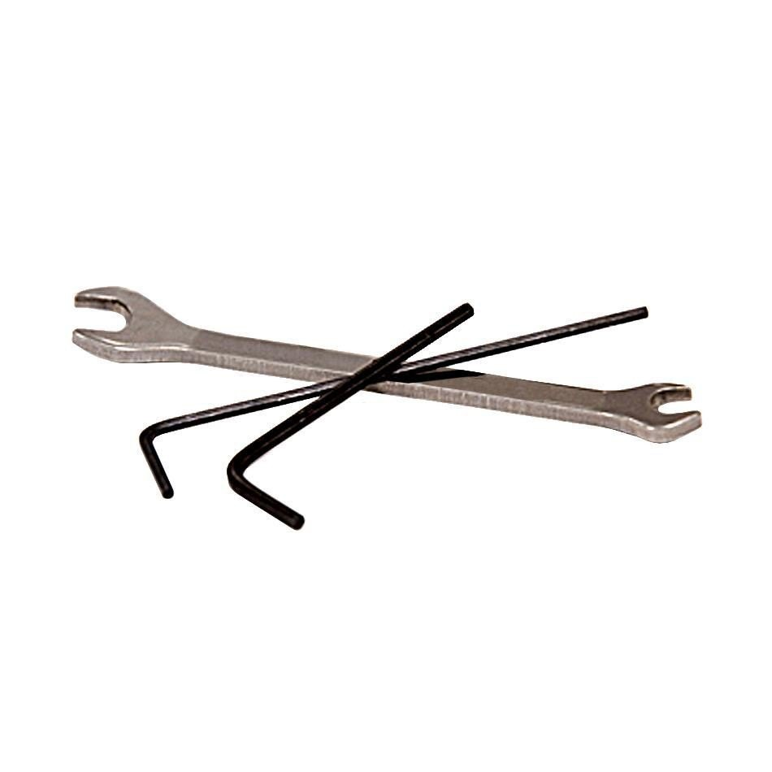
Tools
6/64’’ Hex Keys – Thicker in profile. Used for black bolts.
5/64” Hex Keys – Thinner in profile. Used for golden bolts (which use golden sockets) and for shaft collars.
Crescent wrenches – Fit KEPS and Nylock nuts.

